Slide 1


Ultimate lights
By James Wall, Cheryl li, Lukas lao beyer, and huyanh hoang

Slide 2



The problem
Getting up in the middle of the night
Fumbling! Stumbling!
Getting up in the morning
Too bright! Too dark! Too tired
Calendar
Oh no, you’re late!

Slide 3

The problem
Most people have a set routine
I.E.
Monday through Friday
Wake up at 7 am
Leave home at 8 am
Arrive home at 6 pm
Go to bed at 10 pm
Saturday and Sunday
Wake up at 10 am
Go to bed at 12 am
More or less set times and schedules

Slide 4
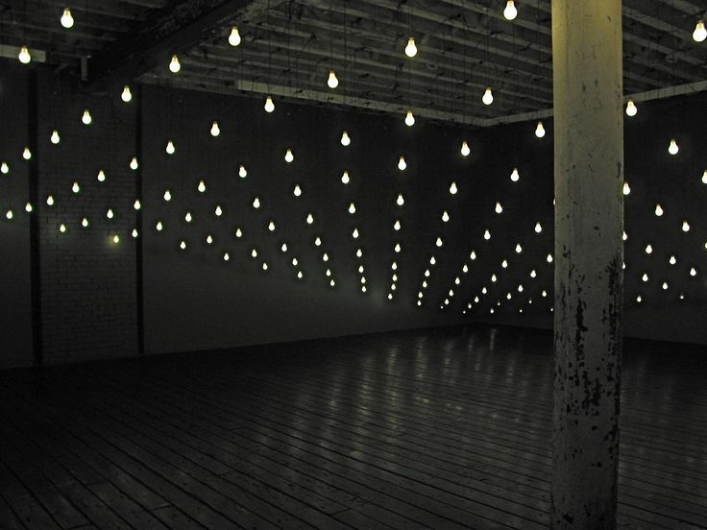
The solution
Smart grid of RGB LED lights
Use motion sensor to detect location
Can track movement, strobe for an alarm, and display other information in the form of colors

Slide 5

applications
Alarms
Sync with Calendar
Mood lighting
Stock information
Really anything that can be expressed in finite signals

Slide 6






technology
AngularJS
Bootstrap
Firebase
Node.js
Python
NativeScript

Slide 7
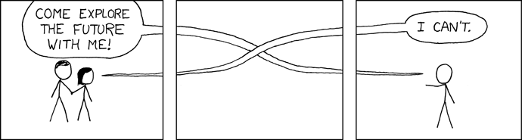
Future steps
Further develop algorithm to more accurately change the modes of individual lights
Beta prototype onto actual light grid
Test across different light bulbs and sensors
Finalize hardware kit

Slide 8




team
James Wall
(WUSTL ‘17)
Huyanh Hoang
(UC Irvine ‘17)
Cheryl Li
(McGill ‘18)
Lukas Lao Beyer
(MIT ‘20)

Slide 9

Thanks for coming!

